Slide 1

WELCOME!
Two Rivers High School
ATHLETIC HALL OF FAME
2018

Slide 2
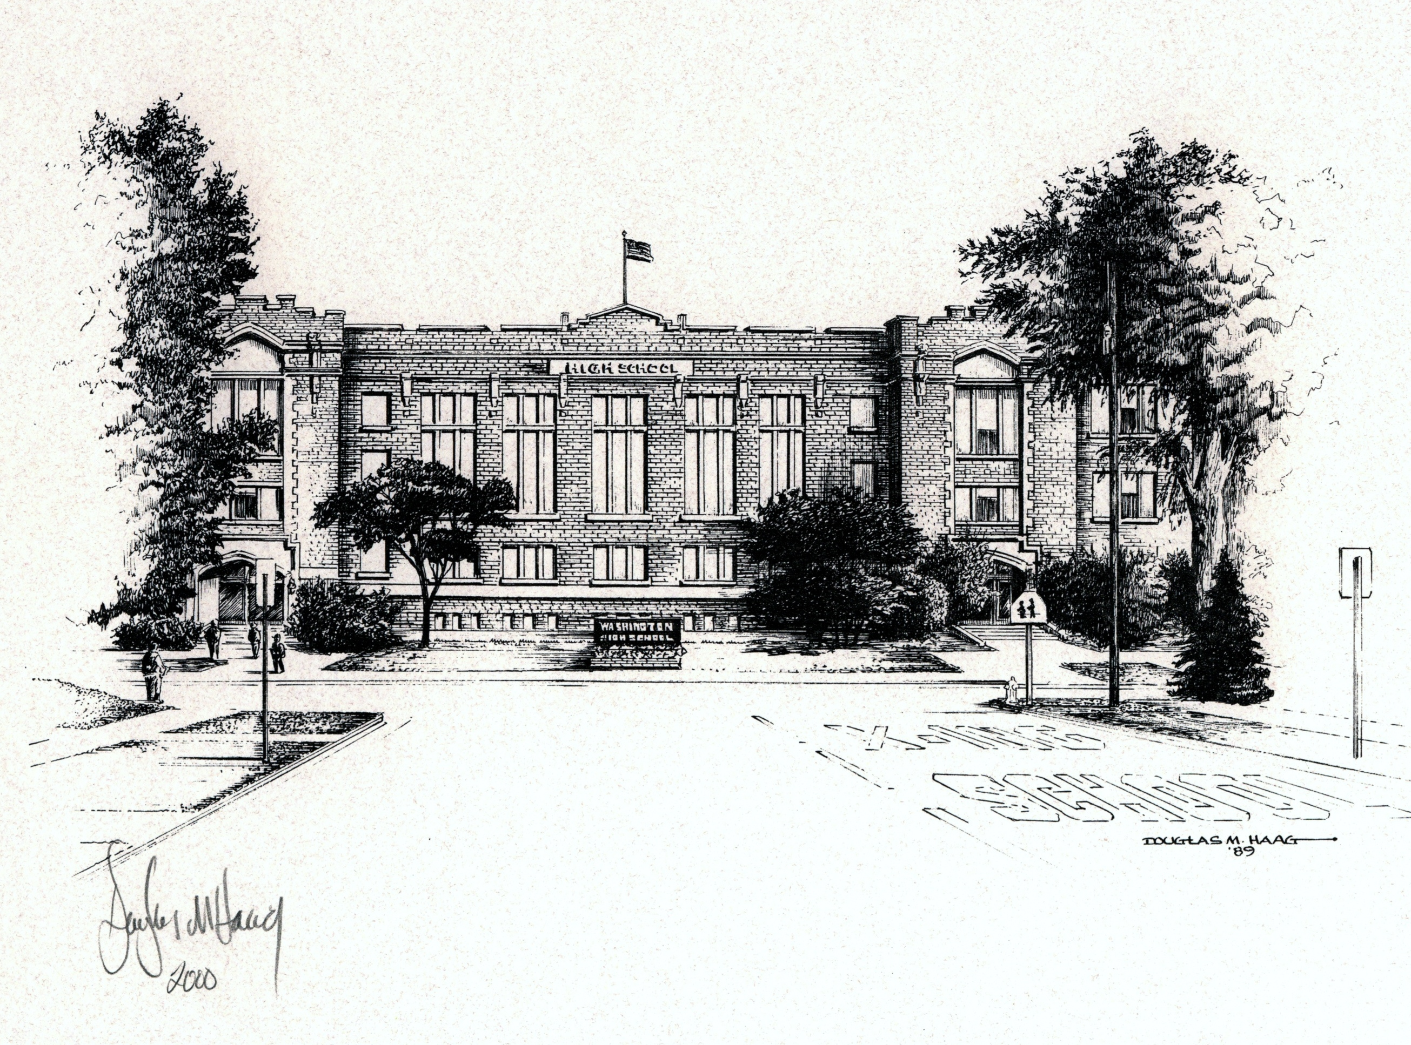


Slide 3
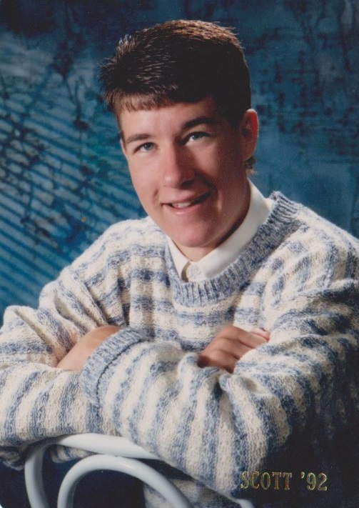
SCOTT JANSKY
1992
Track
X-Country

Slide 4
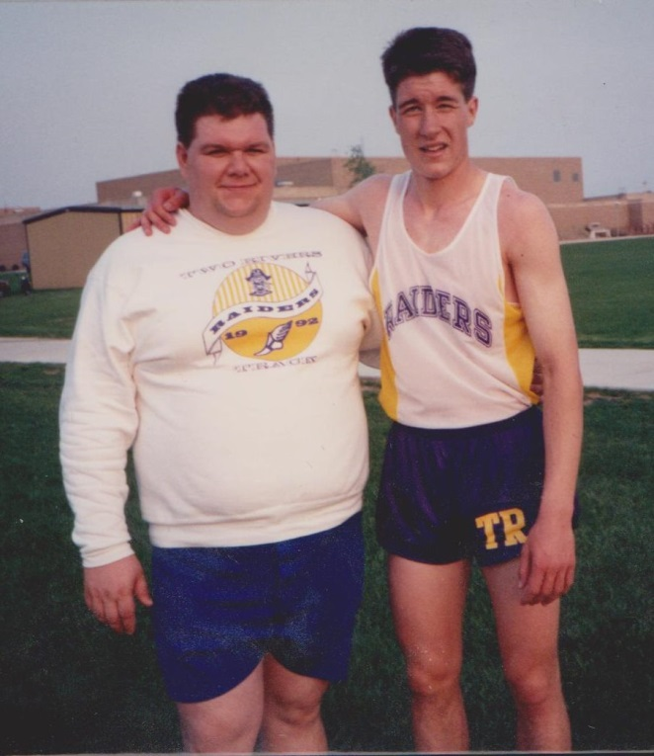
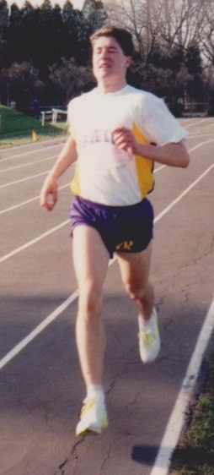

Slide 5
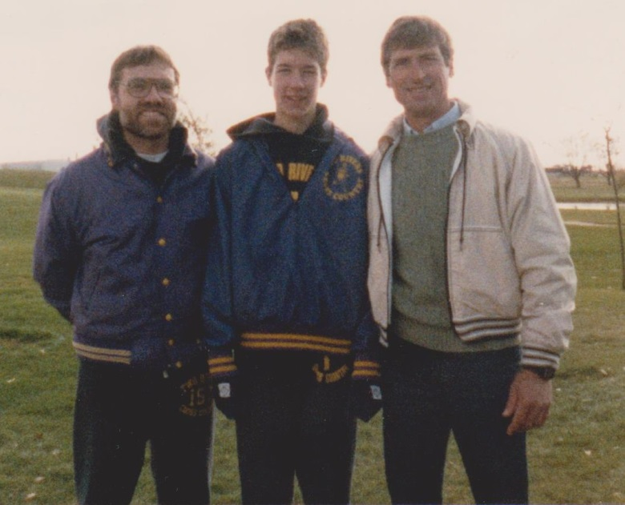
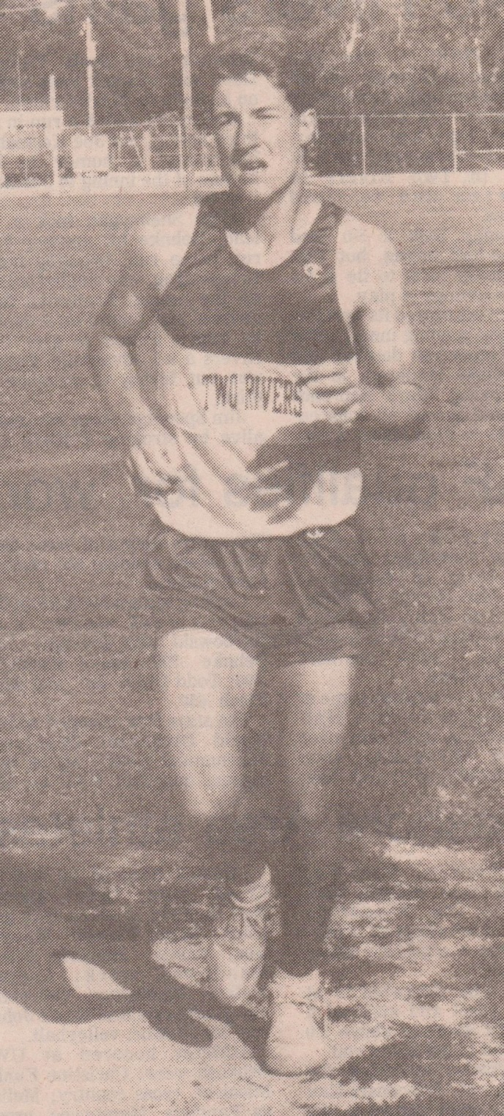

Slide 6
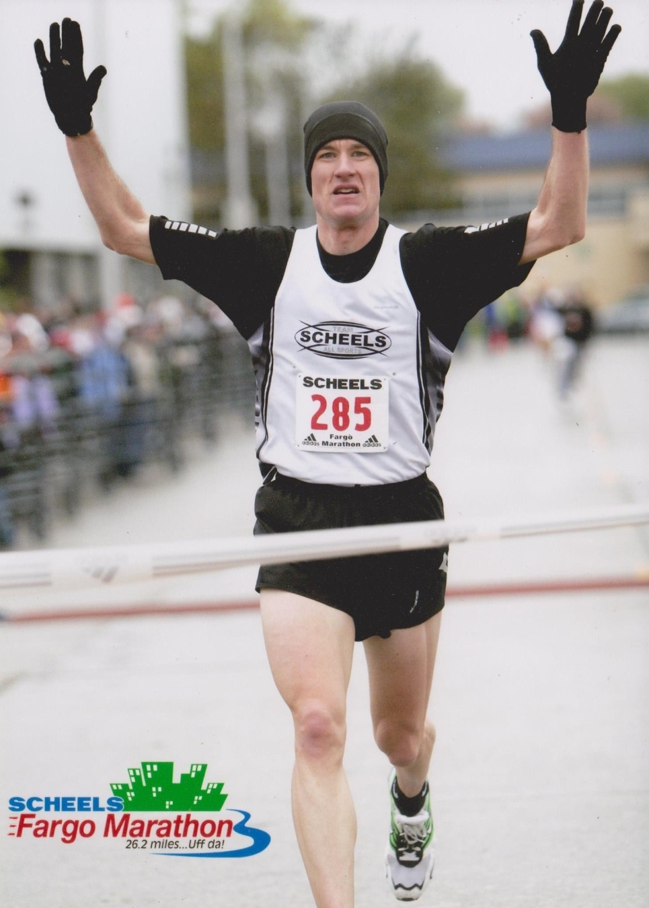

Slide 7
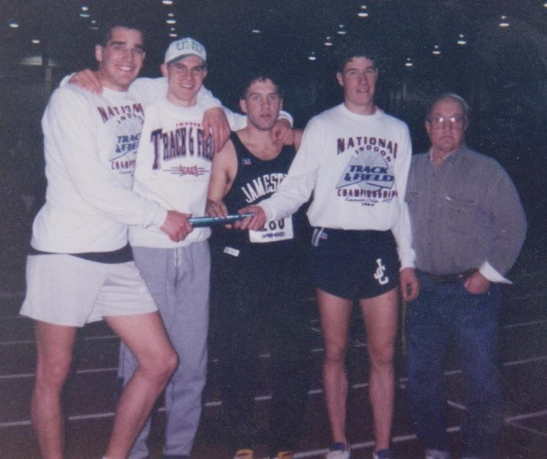

Slide 8
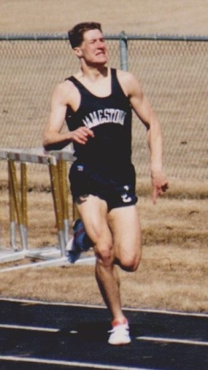

Slide 9
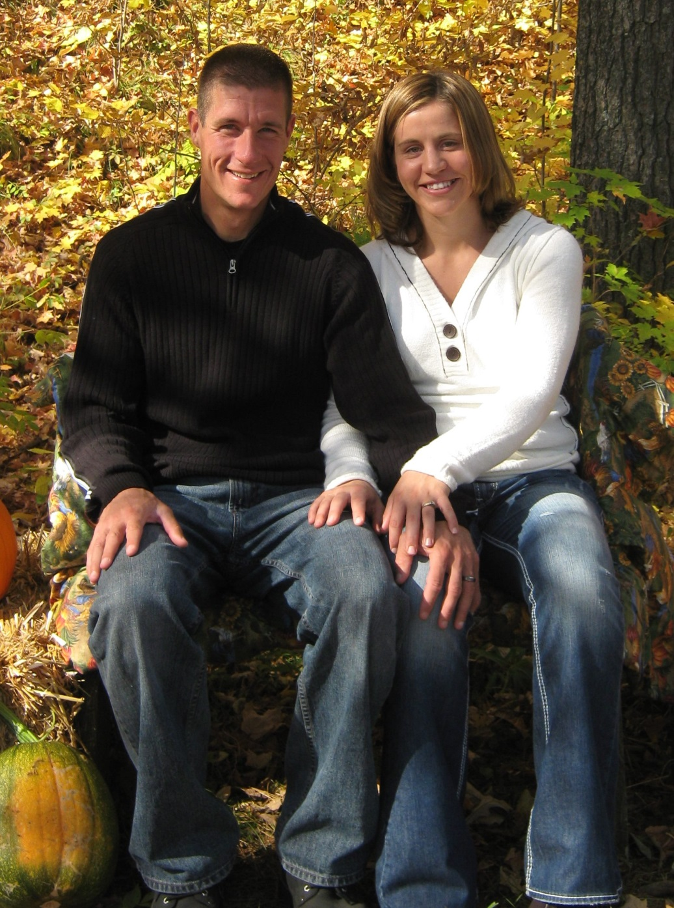
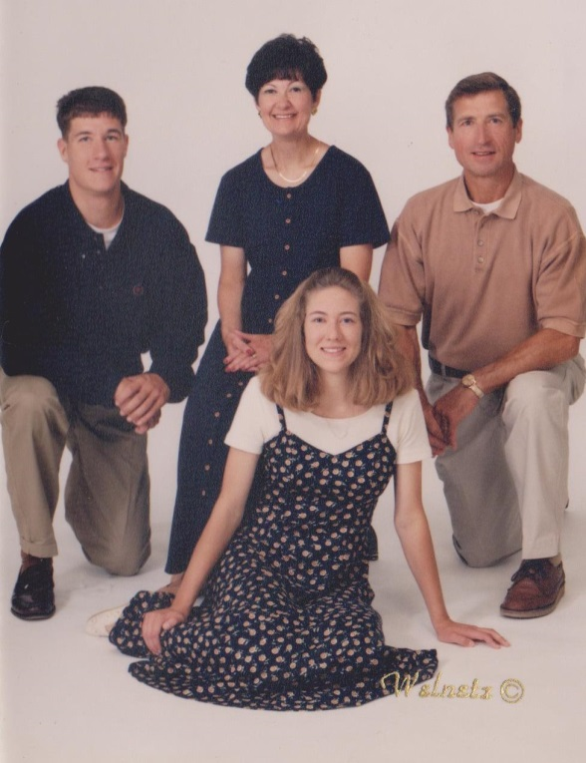


Slide 10
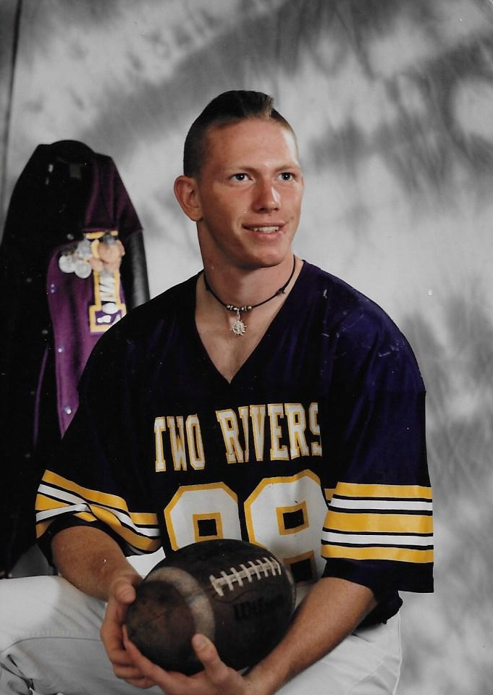
CHRIS MENDEN
1995
Football
Track

Slide 11
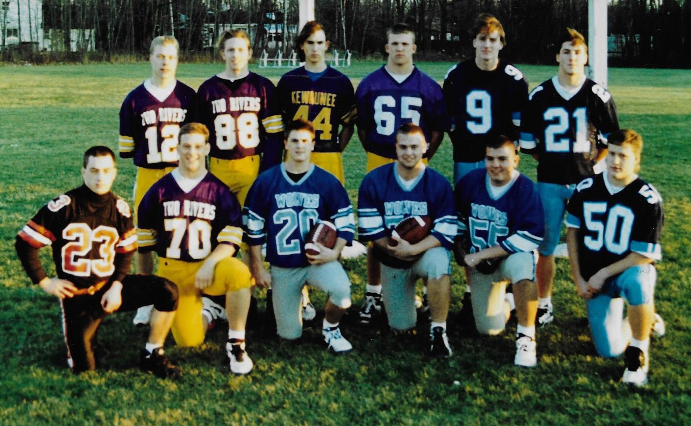

Slide 12
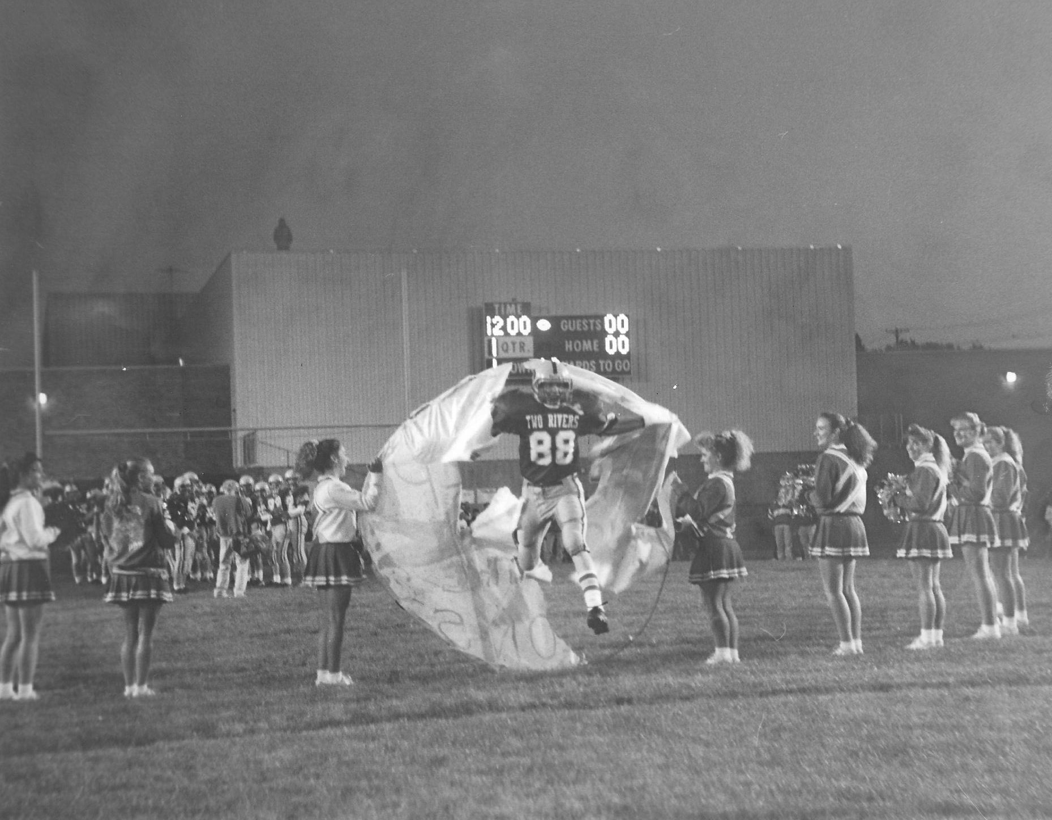

Slide 13
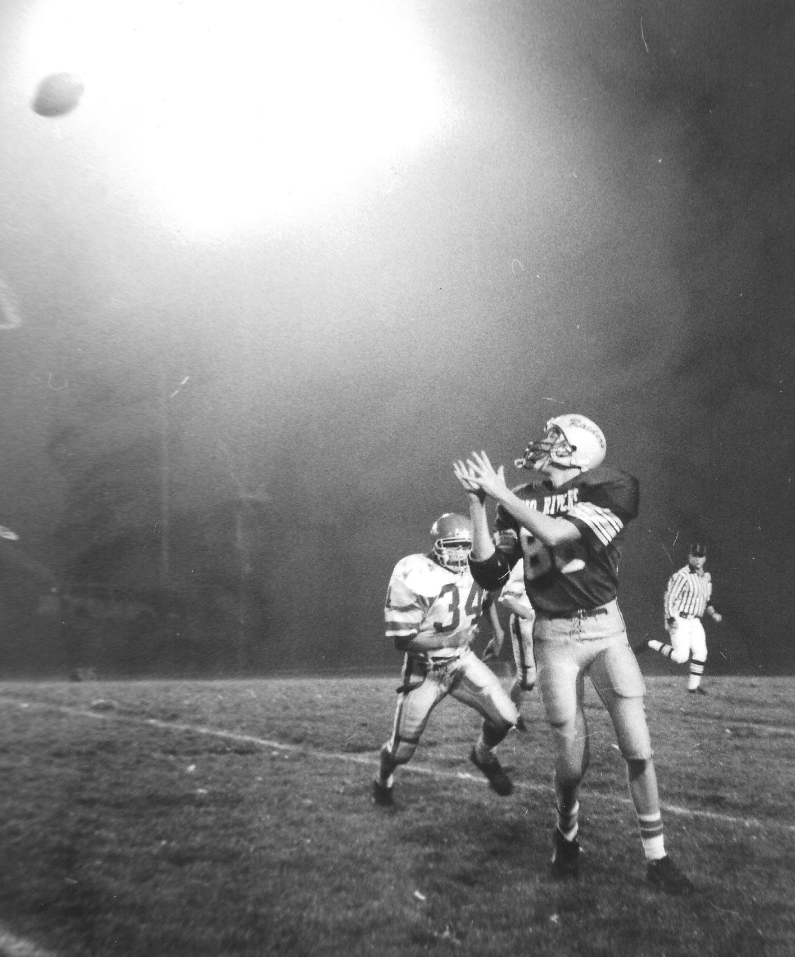

Slide 14
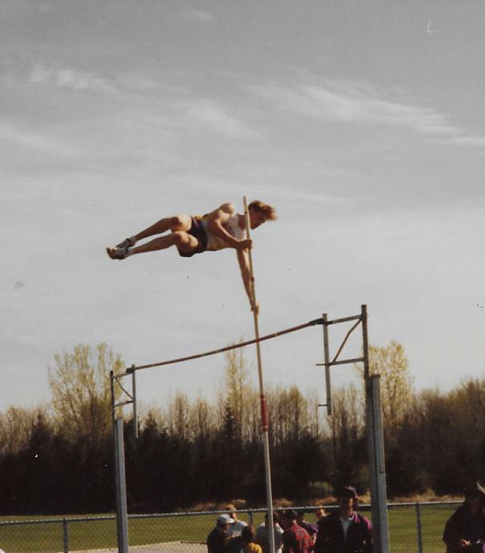
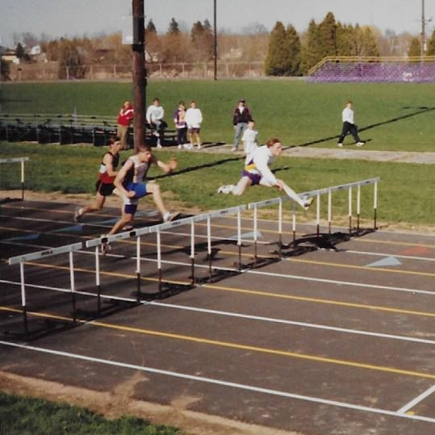

Slide 15
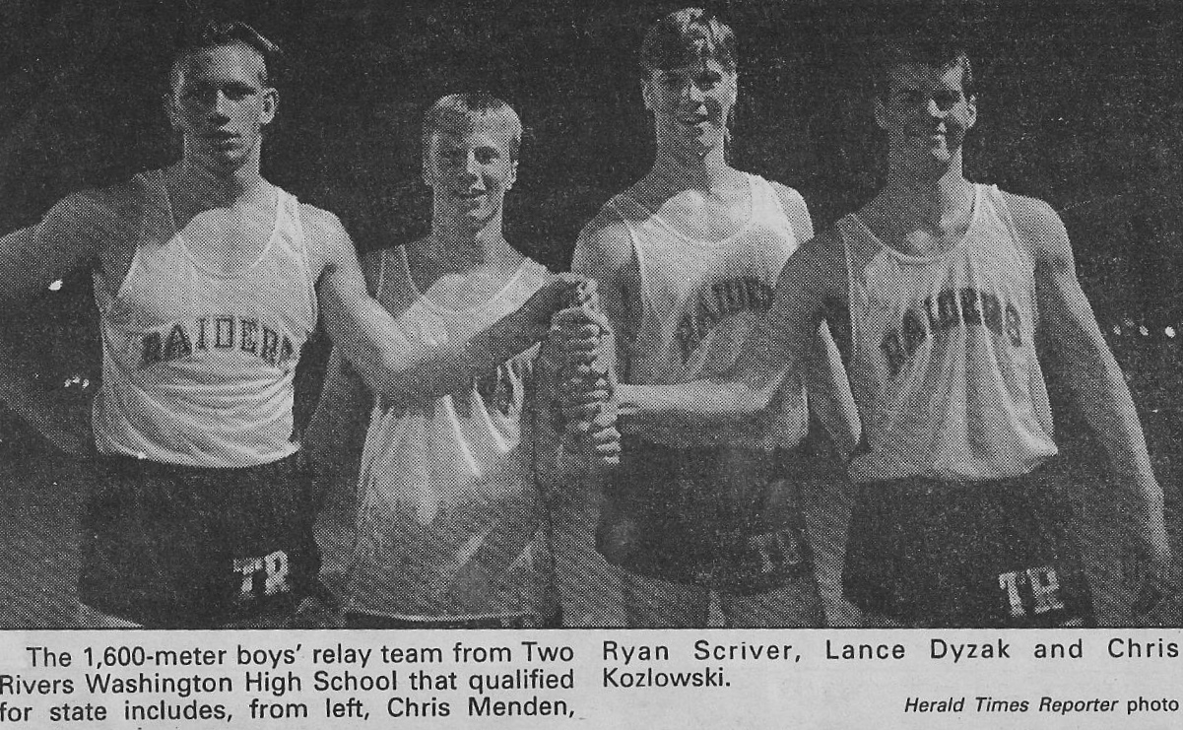

Slide 16
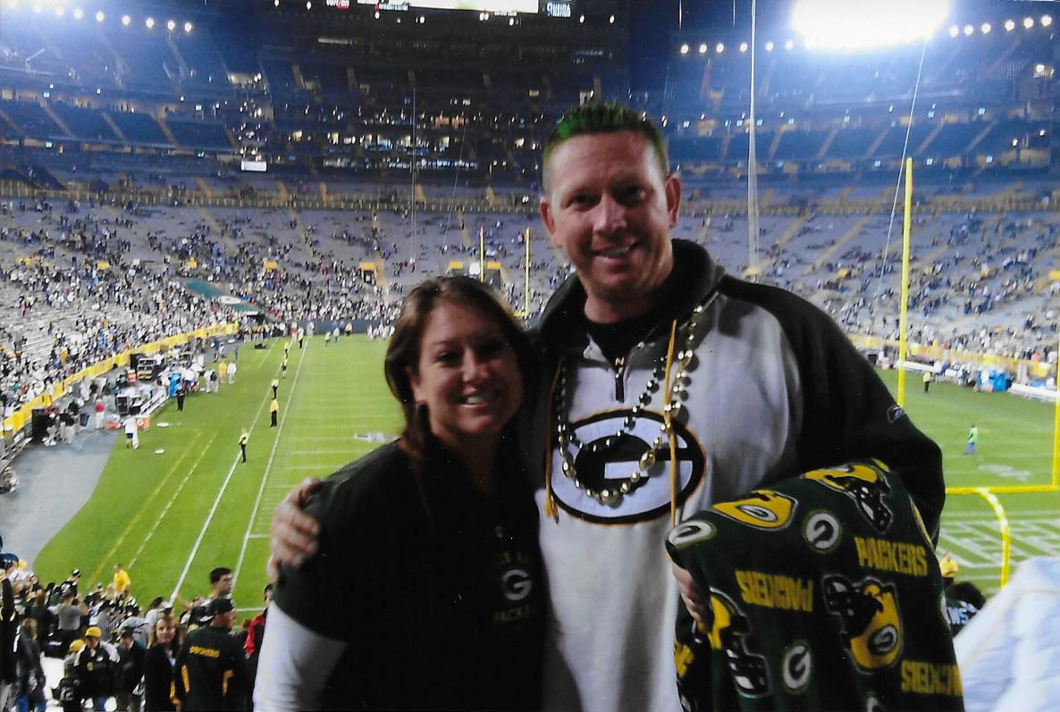

Slide 17
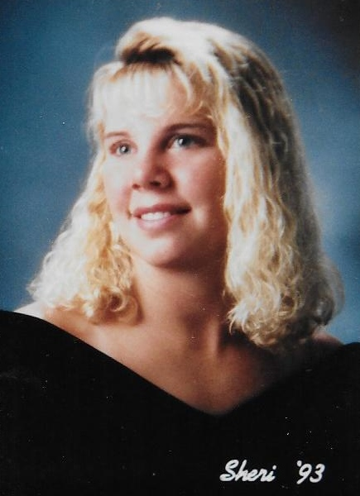
SHERI RANK
1993
Softball
Basketball
Swimming
Tennis

Slide 18
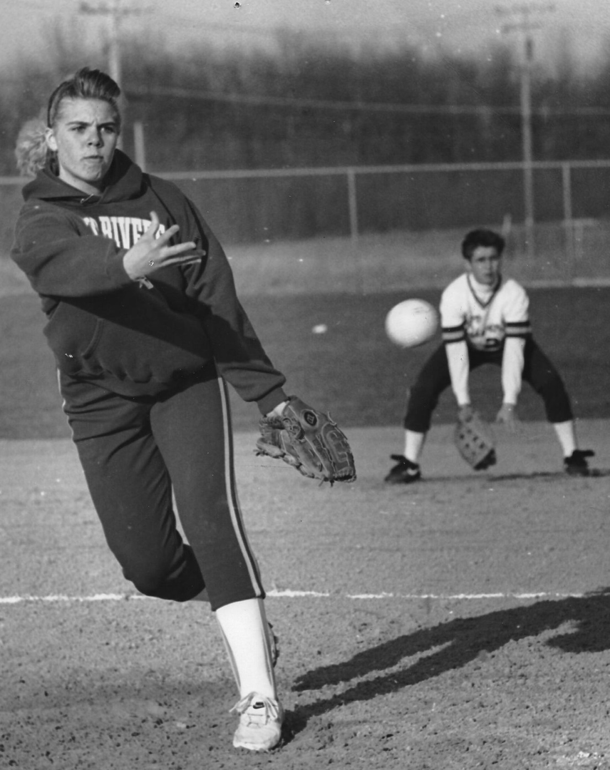
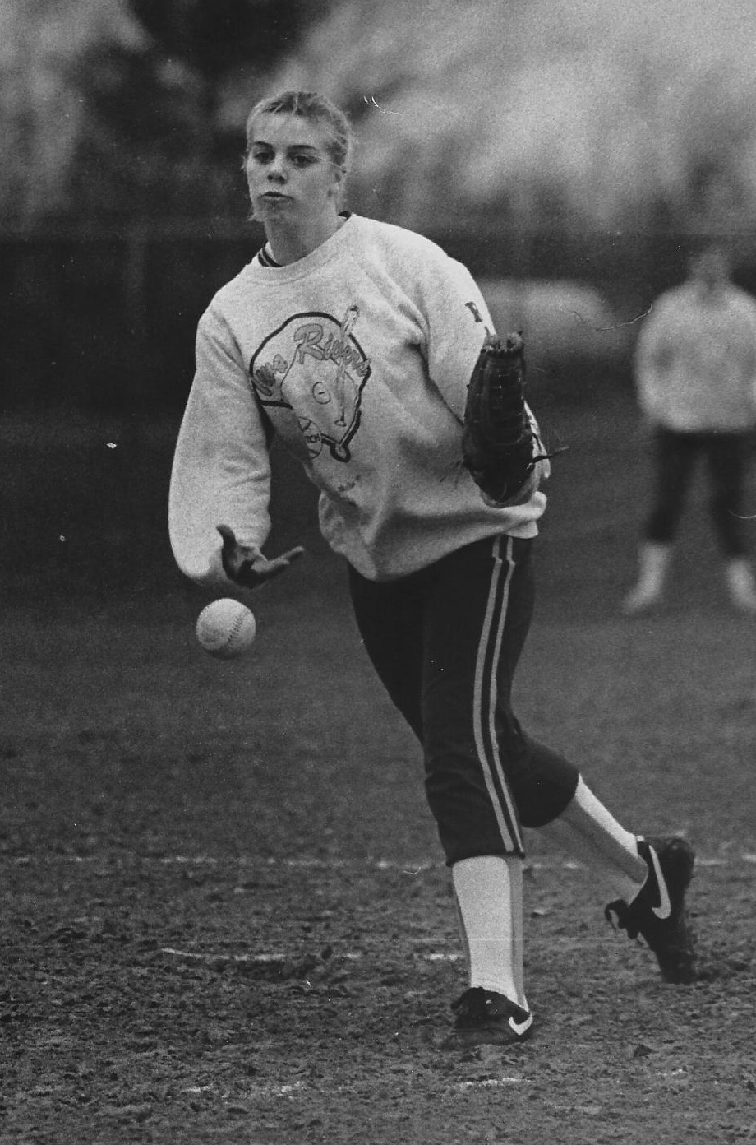

Slide 19
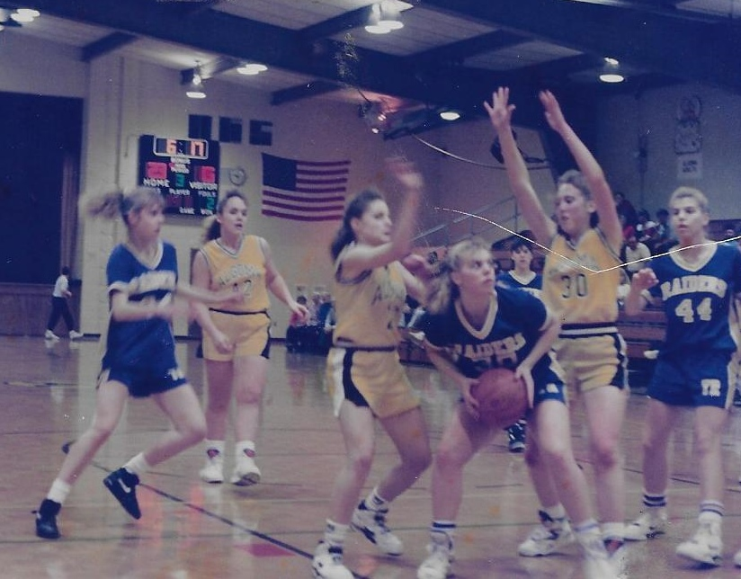

Slide 20
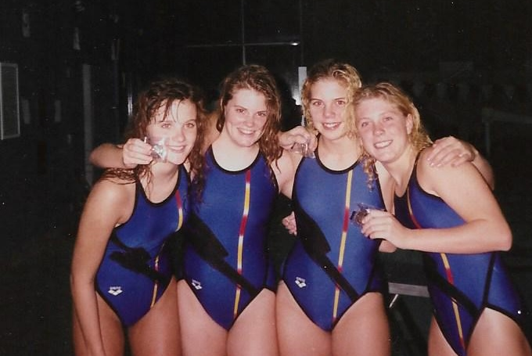

Slide 21
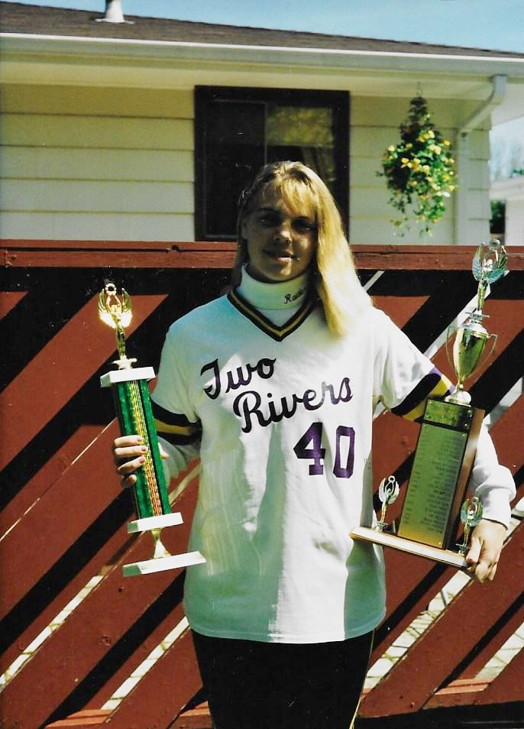

Slide 22
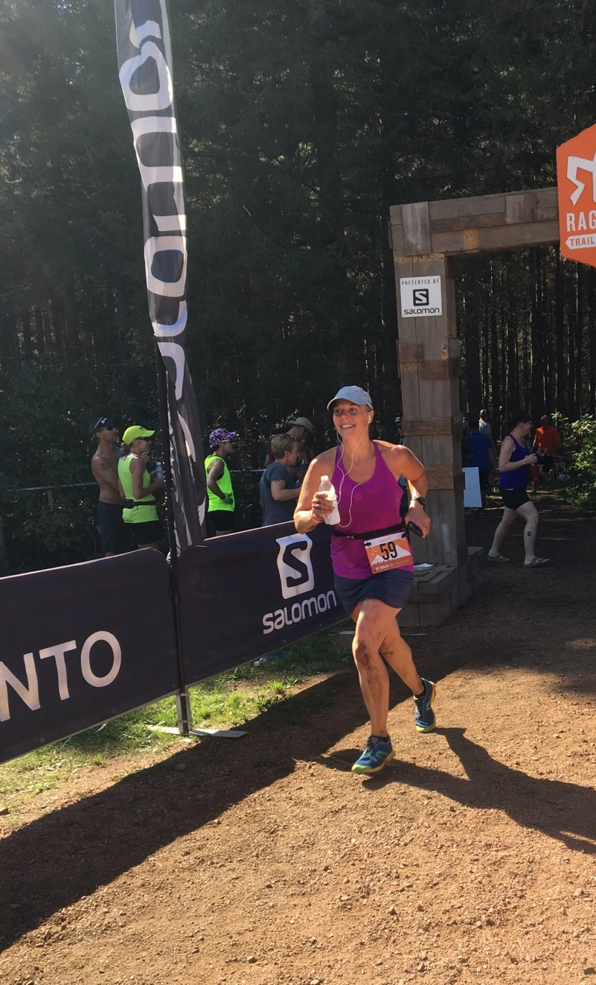

Slide 23
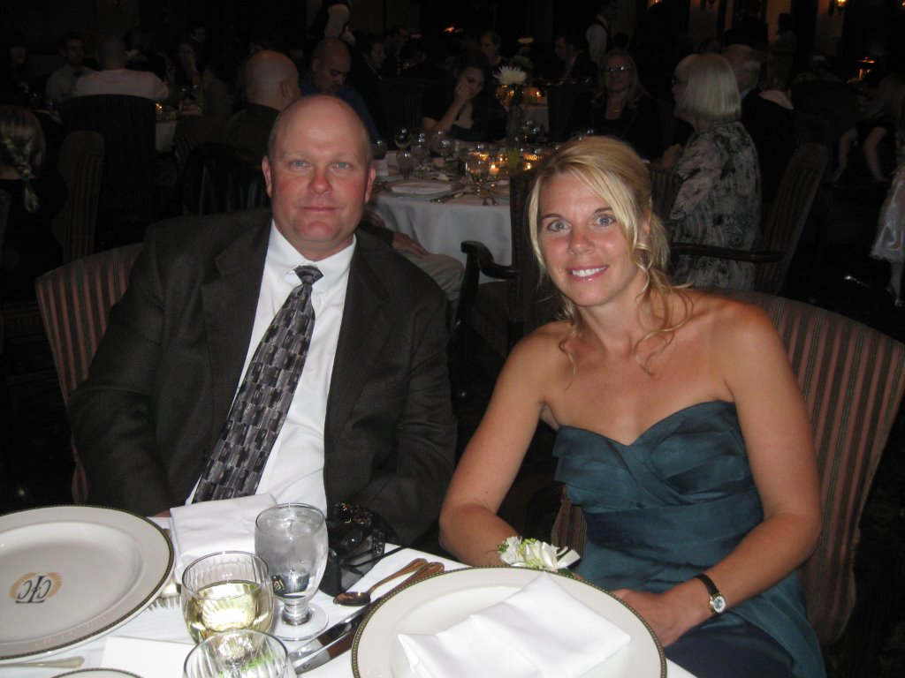

Slide 24
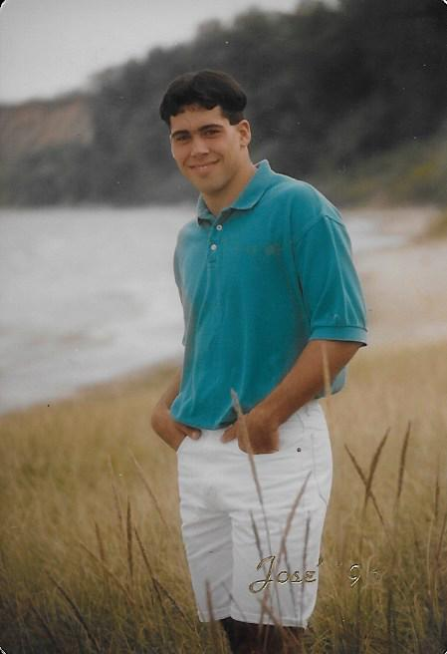
JOSE GARCIA
1996
Basketball
Football
Track

Slide 25
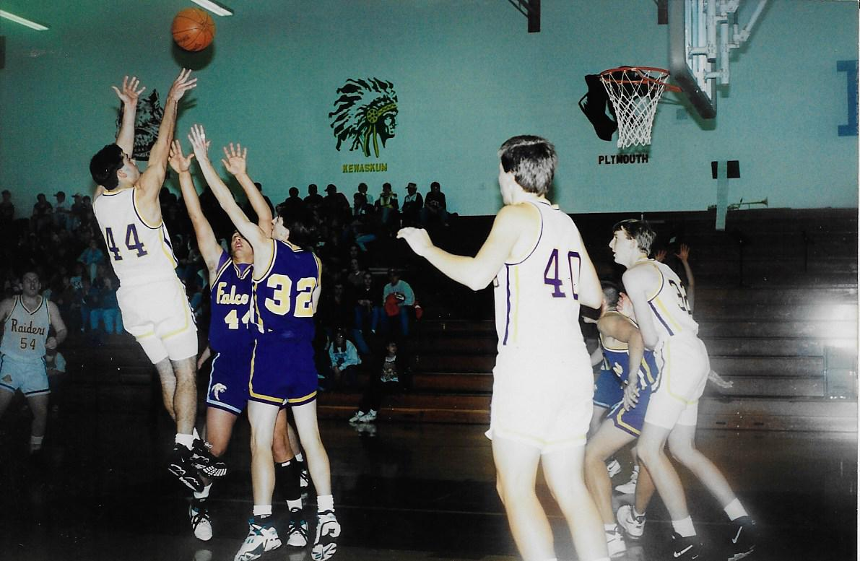

Slide 26
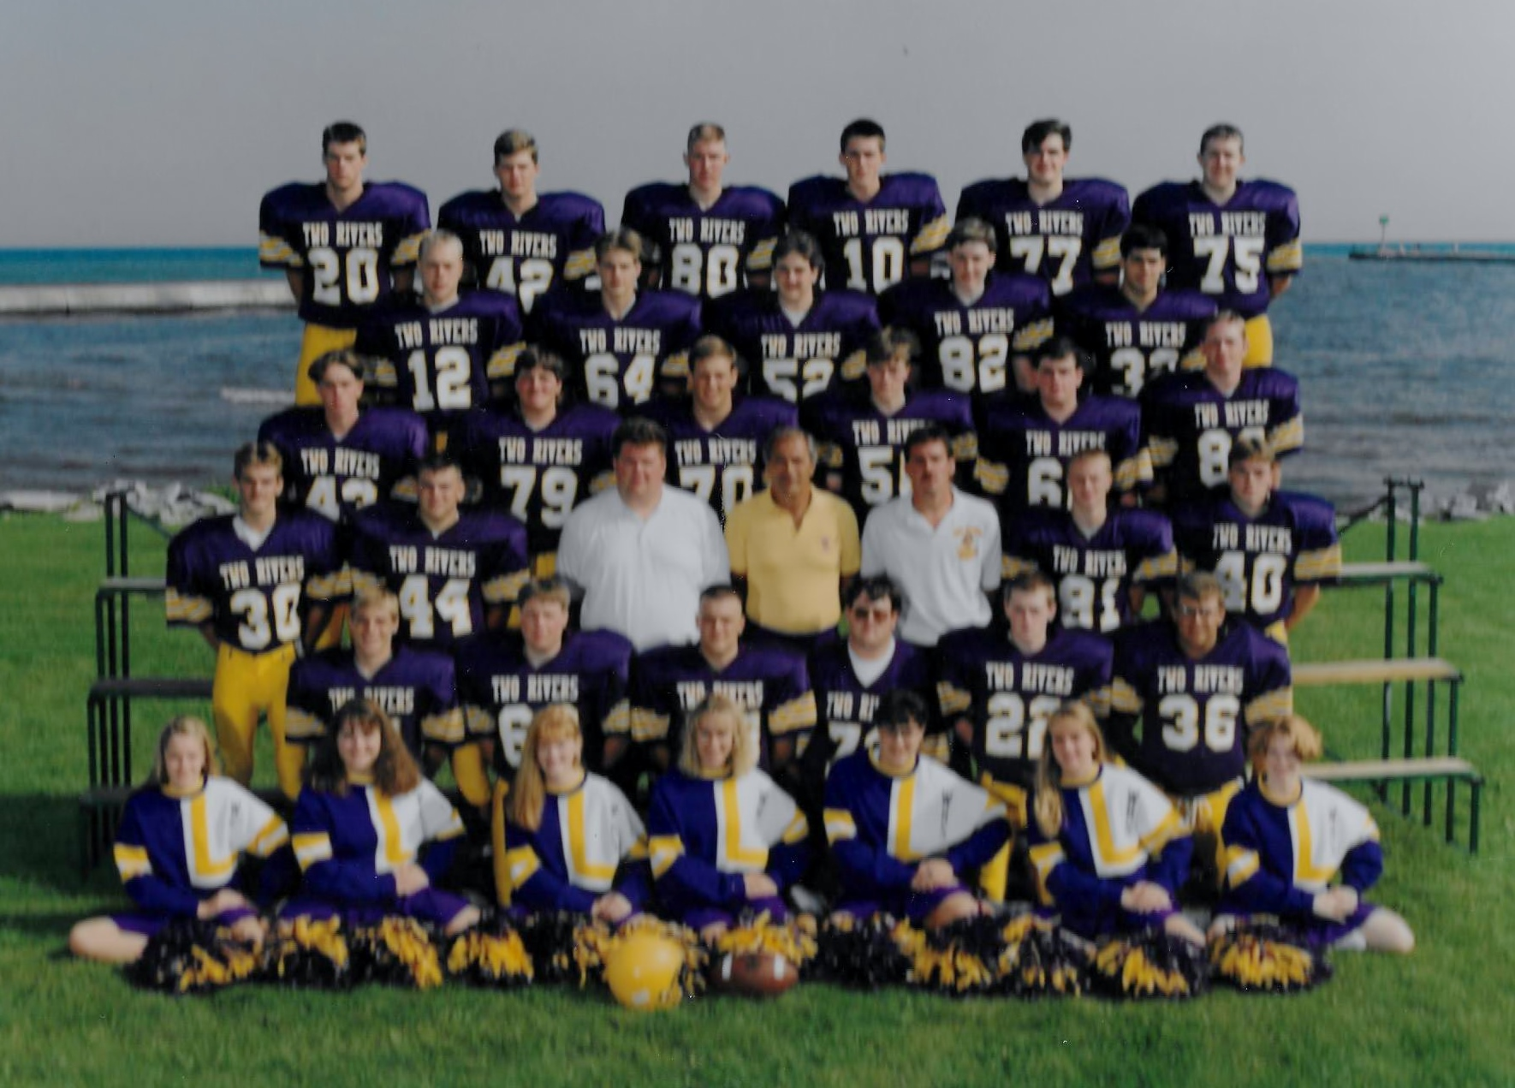

Slide 27
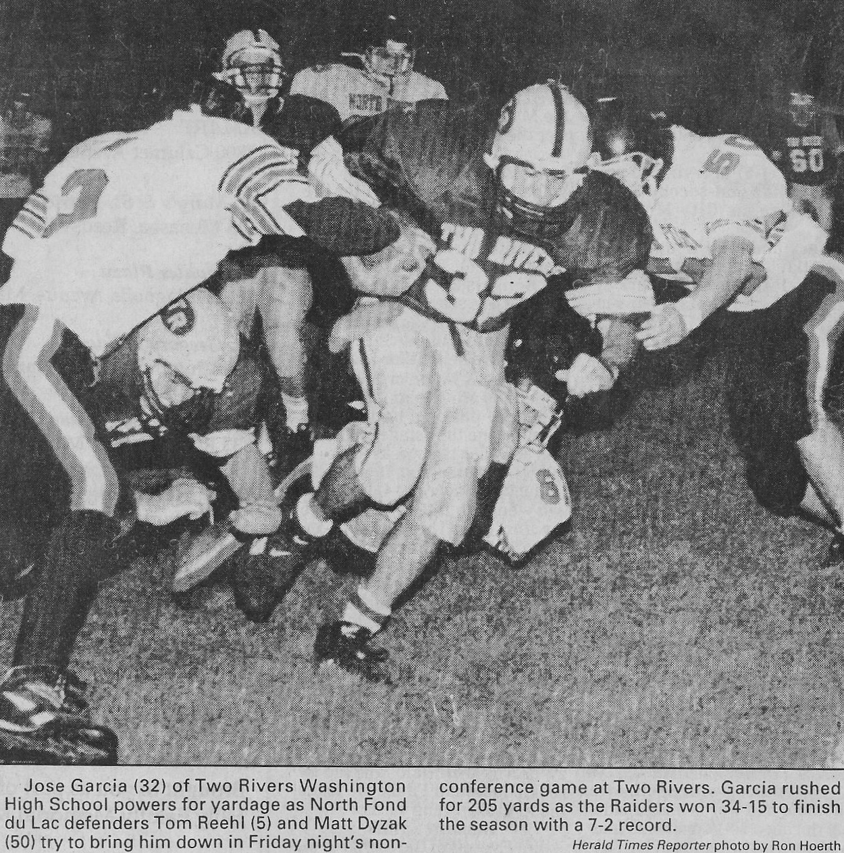

Slide 28
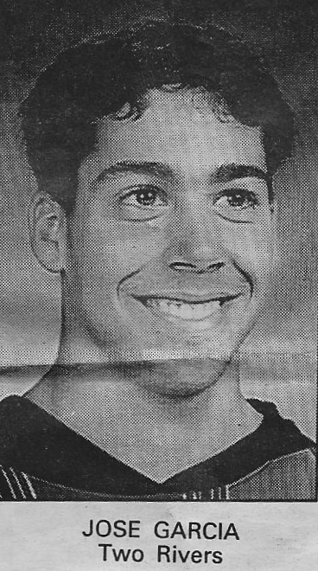
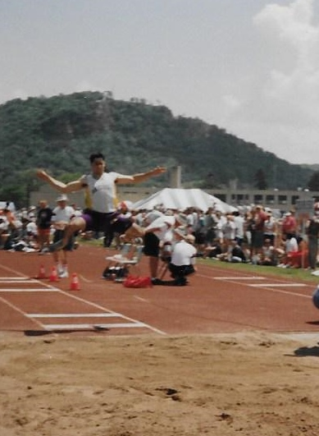

Slide 29
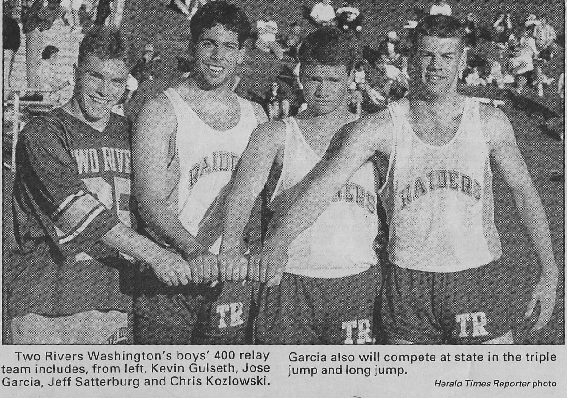

Slide 30
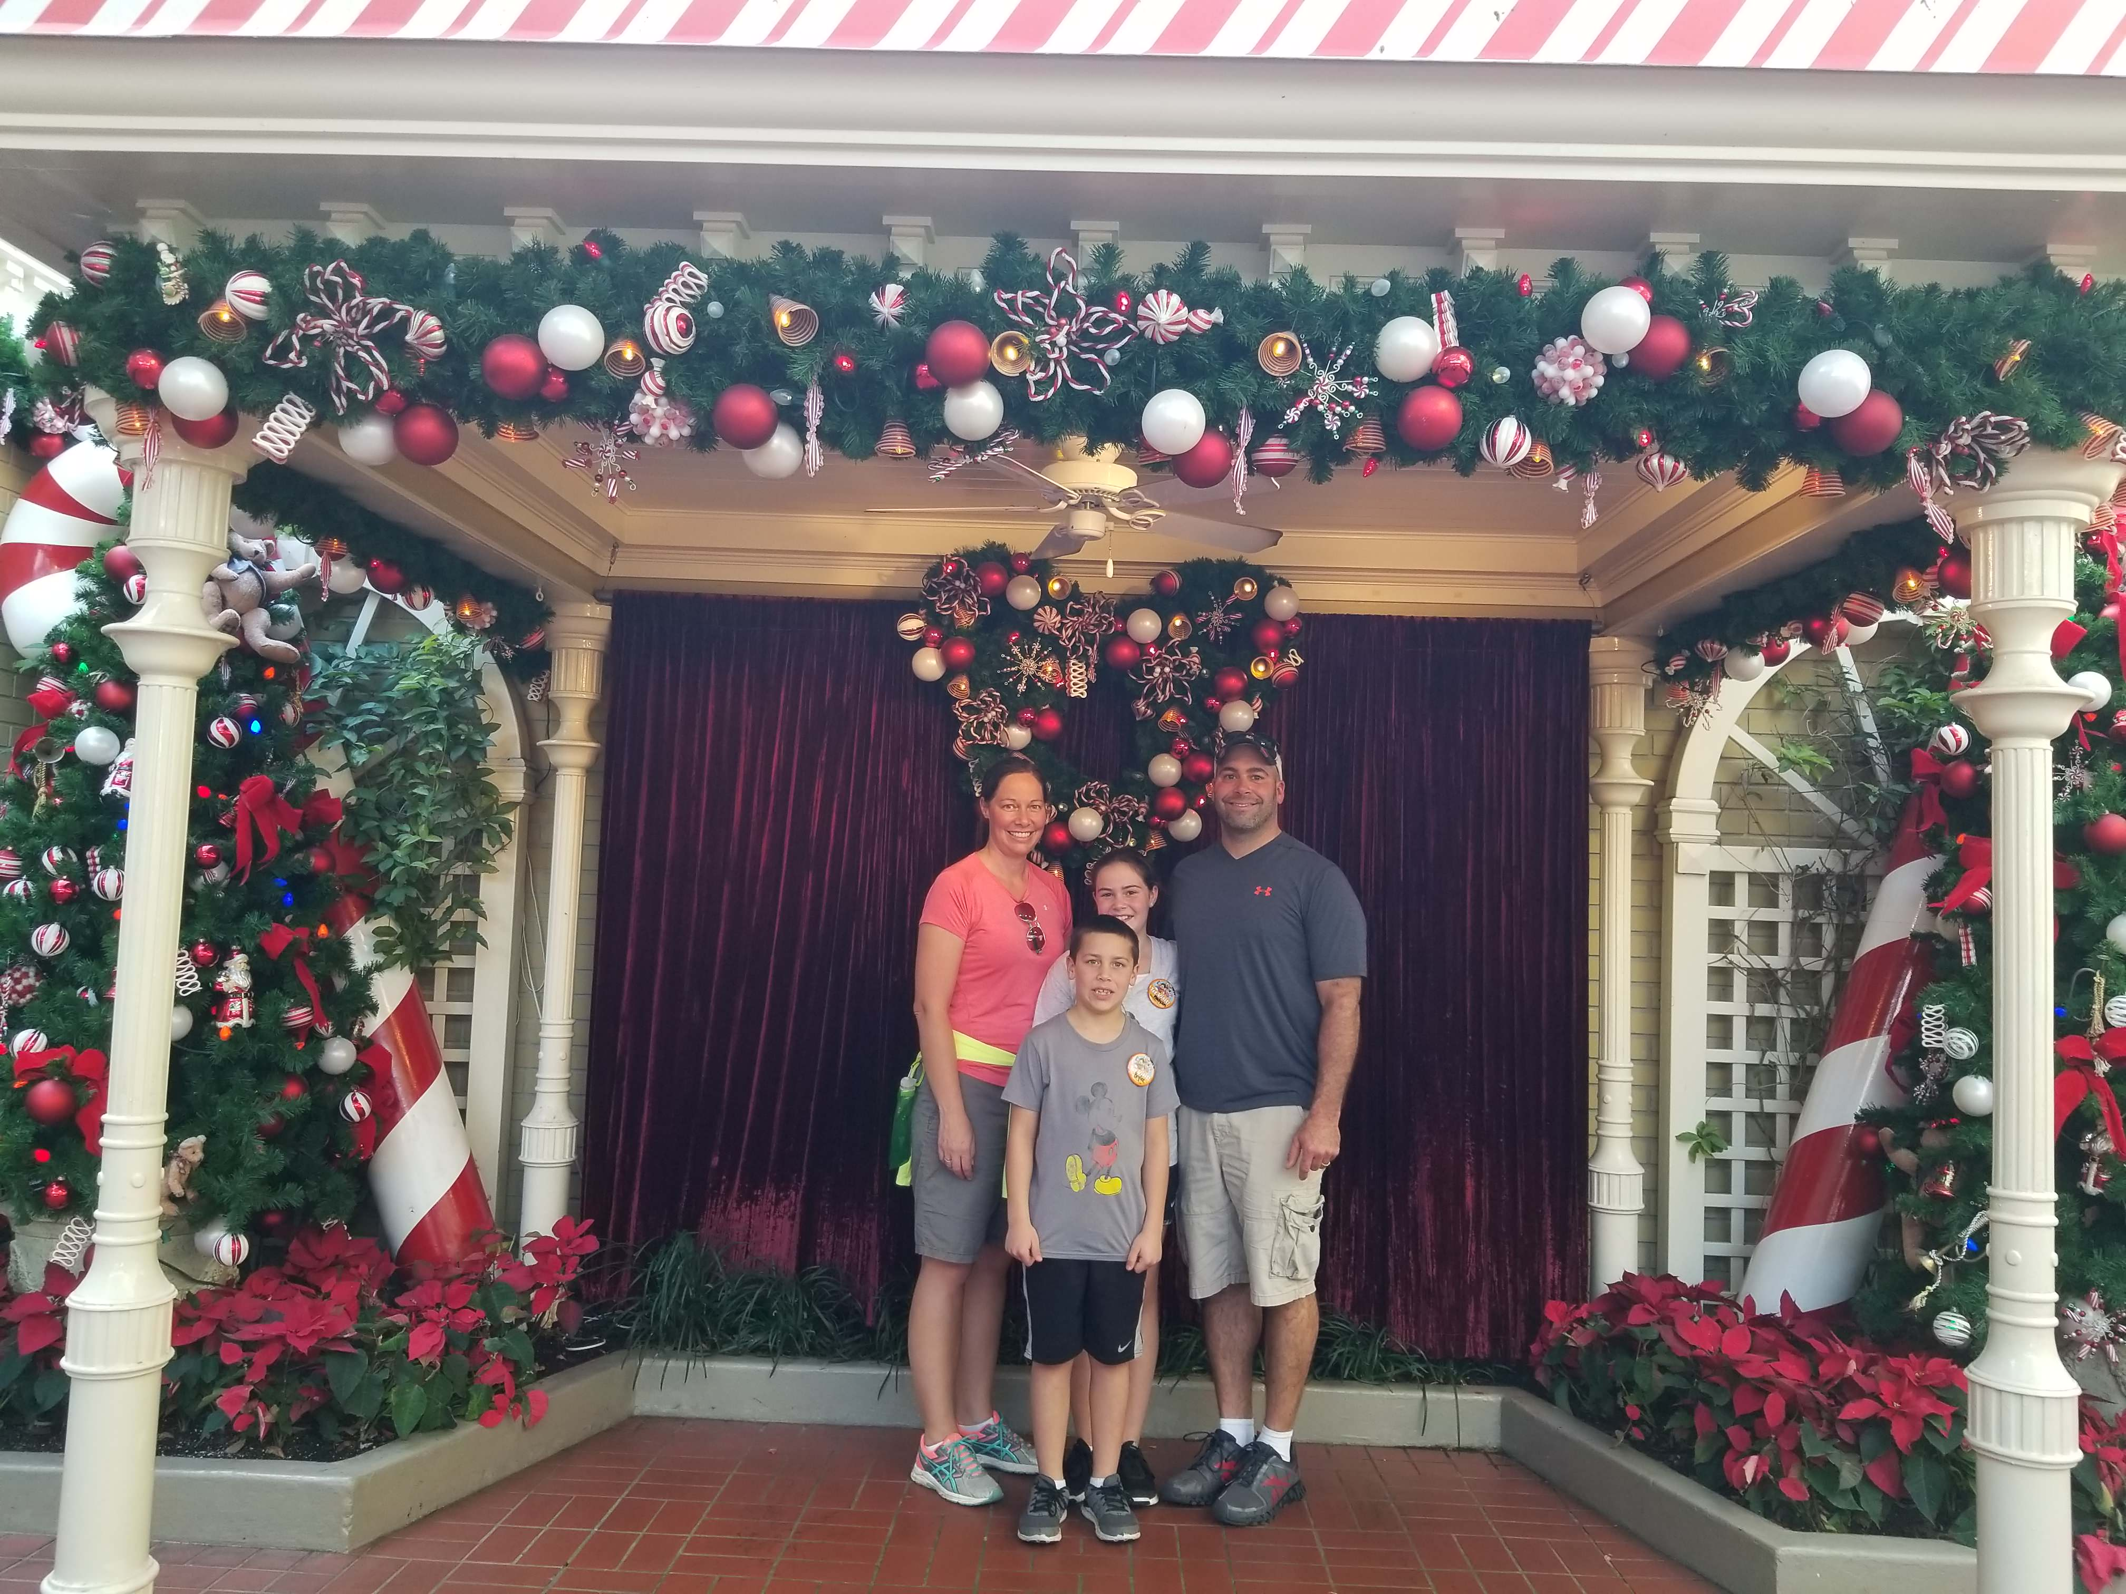

Slide 31
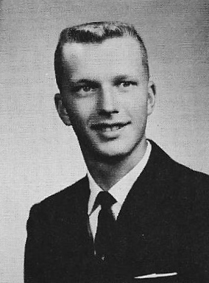
PAUL LAFOND
1964
Basketball
Track

Slide 32
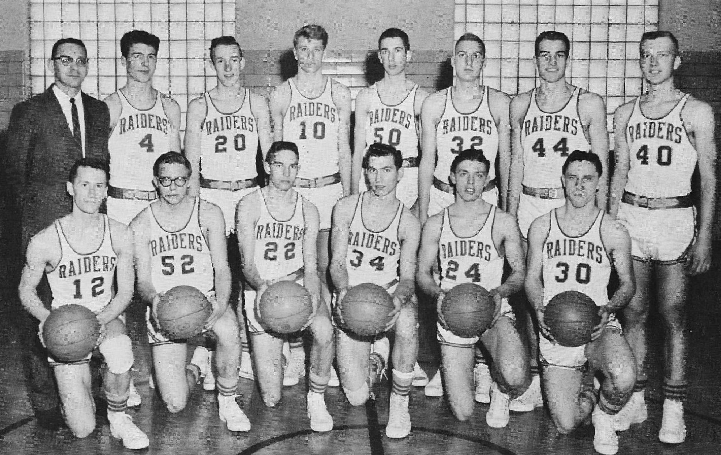

Slide 33
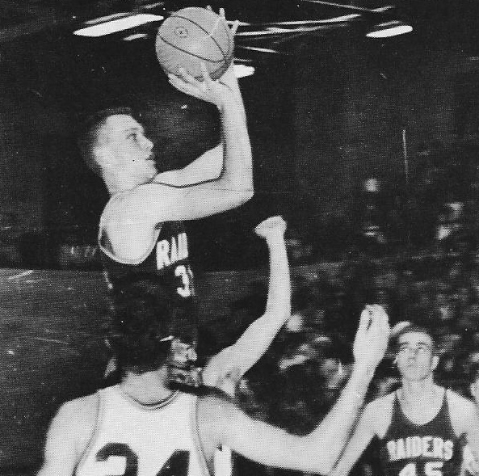

Slide 34
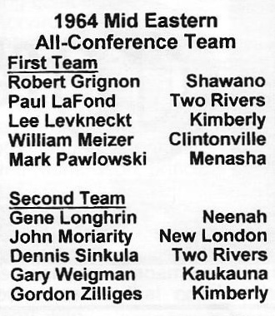

Slide 35
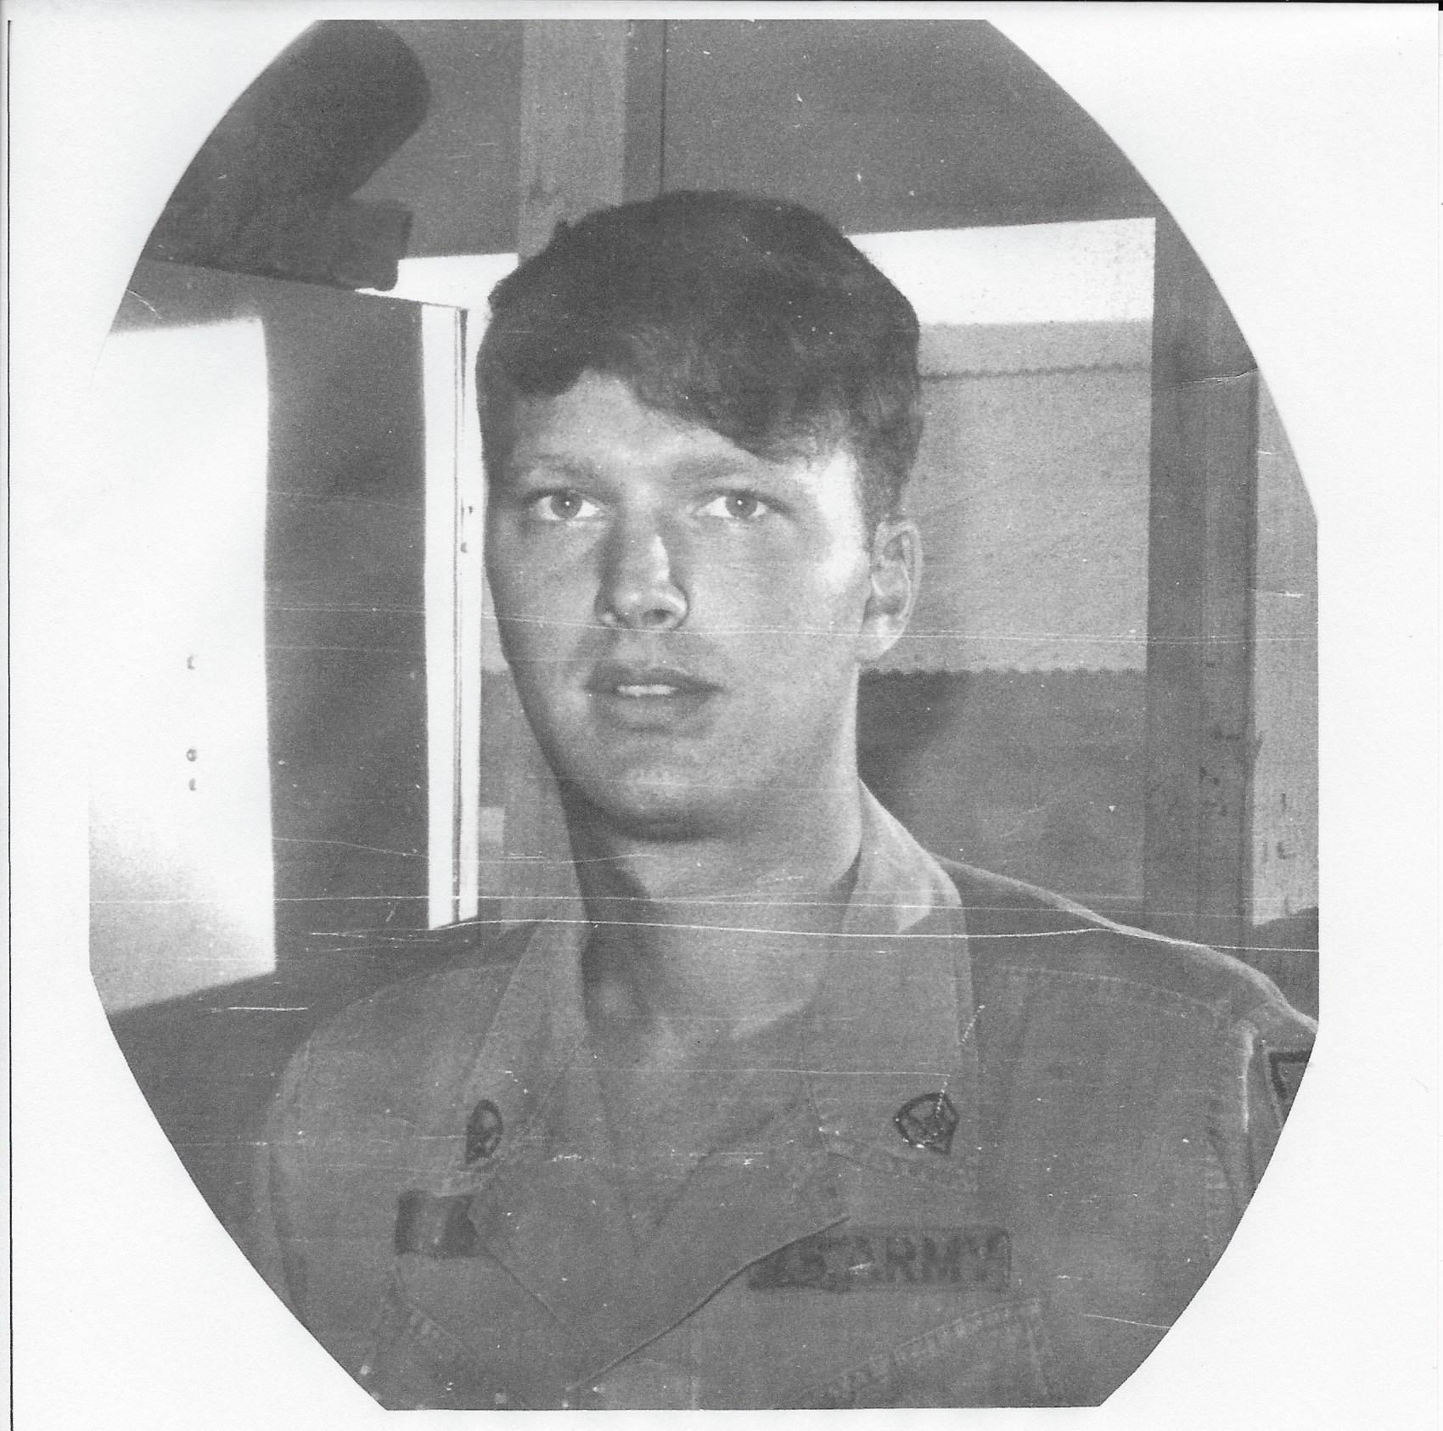

Slide 36
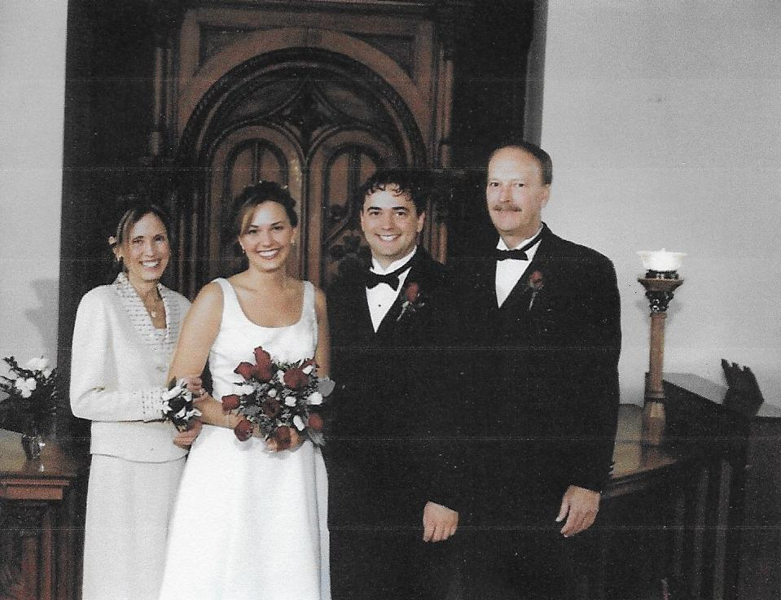
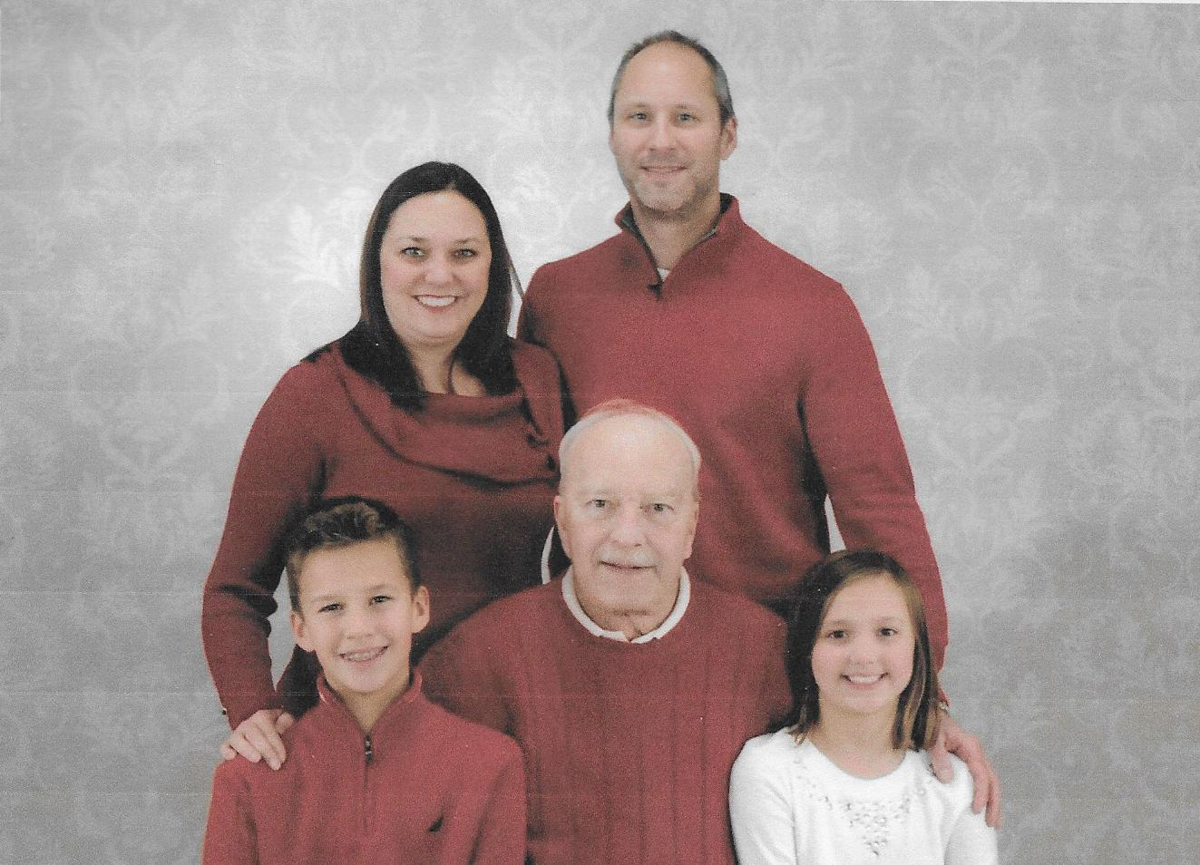

Slide 37

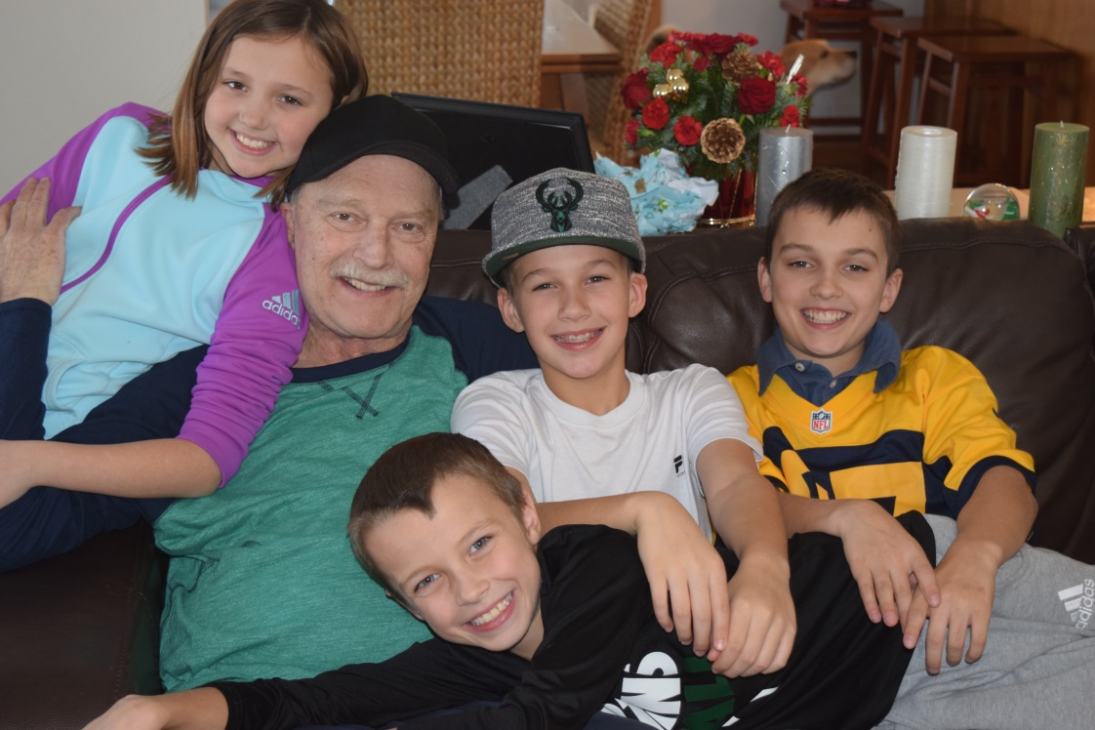

Slide 38
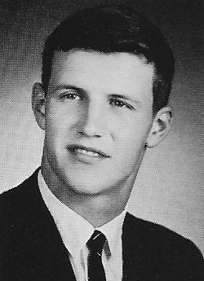
TOM TURMAN
1968
Basketball
Football
Baseball

Slide 39
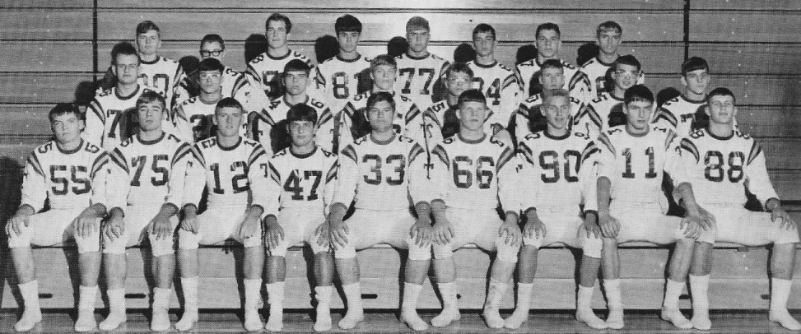

Slide 40
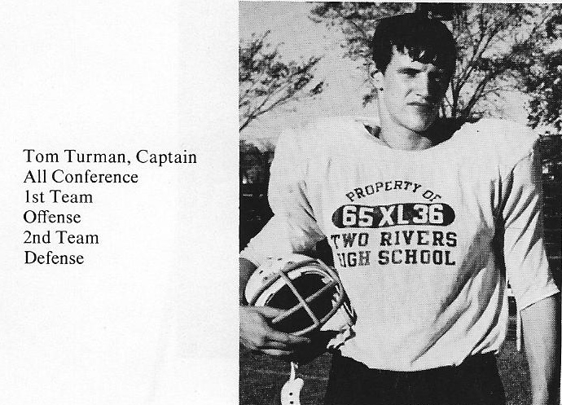

Slide 41
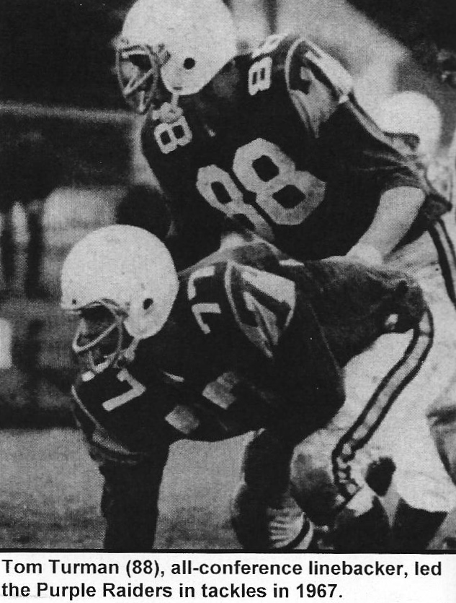
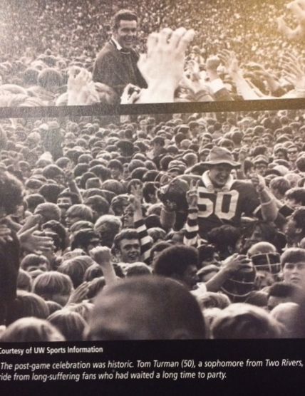

Slide 42
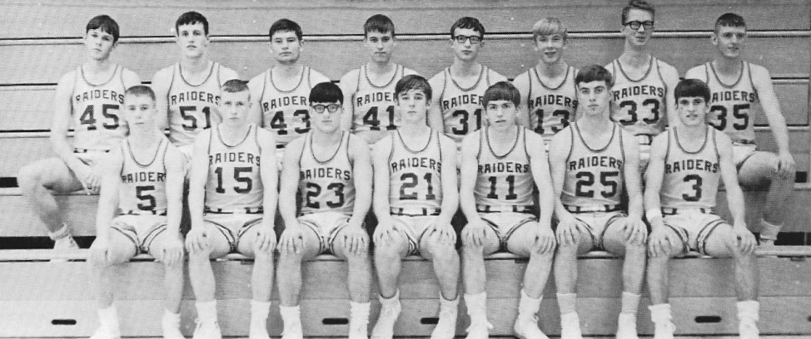

Slide 43
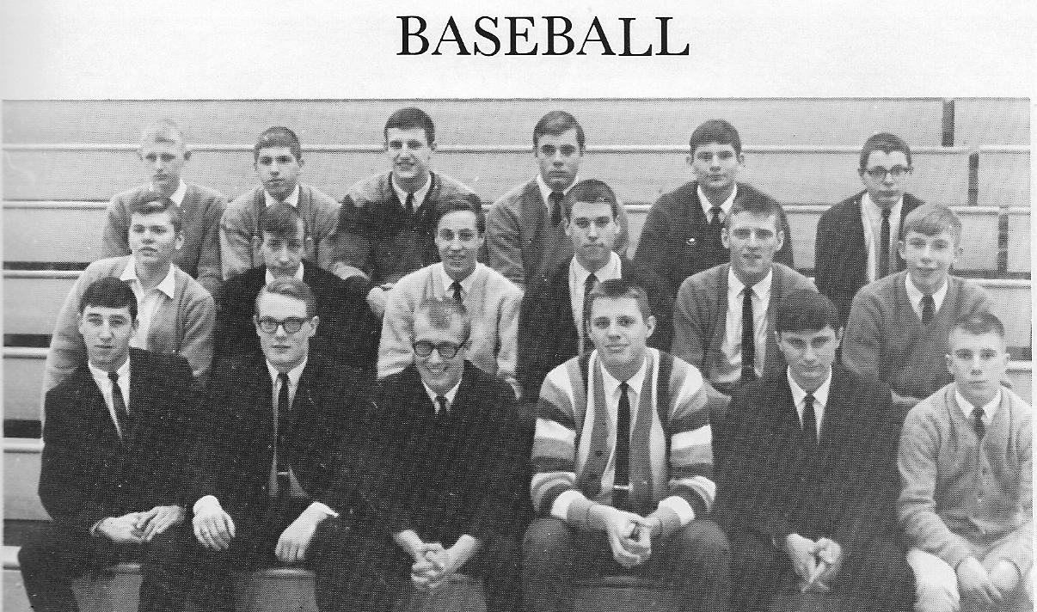

Slide 44



Slide 45

AMY SPAETH
1986
Basketball
Volleyball
Track

Slide 46


Slide 47


Slide 48



Slide 49


Slide 50


Slide 51


Slide 52

JACKIE THOME
1986
Volleyball
Basketball
Track

Slide 53


Slide 54


Slide 55


Slide 56


Slide 57


Slide 58

SHAUN REZACHEK
1996
Golf
Basketball

Slide 59


Slide 60


Slide 61


Slide 62


Slide 63





Slide 64


Slide 65

CORY SHIMULUNAS
1990
Basketball
Football

Slide 66


Slide 67


Slide 68


Slide 69


Slide 70




Slide 71


Slide 72

CHRIS SATTERBURG
1994
Football
Track

Slide 73


Slide 74


Slide 75


Slide 76


Slide 77



Slide 78



Slide 79










Slide 80
CONGRATULATIONS
2018
Hall of Fame
Inductees
1964 Paul LaFond
1968 Tom Turman
1986 Amy Spaeth
1986 Jackie Thome
1990 Cory Shimulunas
1992 Scott Jansky
1993 Sheri Rank
1995 Chris Menden
1996 Jose Garcia
1996 Shaun Rezachek
1994 Chris Satterburg

Slide 81

2011 HALL OF FAME

Slide 82

2012 HALL OF FAME

Slide 83

2013 HALL OF FAME

Slide 84

2014 HALL OF FAME

Slide 85

2015 HALL OF FAME

Slide 86

2016 HALL OF FAME

Slide 87

2017 HALL OF FAME

Slide 88


Slide 89
Thank You
Atrium Health and Senior Living, Sponsor
Inductee Families for Photographs
TRHS Band Andy Pagel, Director
Barb Jandrin, Technical Assistance
Stacy Watzka, Food Service Director
Malley Printing Company
Hall of Fame Committee
Two Rivers High School Administration
Two Rivers High School Staff
Music for Sports. Sports Themes. 2011. Web

